Slide 1
∙ PROGRAM OF “PHYSICS”
Lecturer: Dr. DO Xuan Hoi
Room 413
E-mail : dxhoi@hcmiu.edu.vn

Slide 2
PHYSICS 4 (Wave, Light, and Atoms )
02 credits (30 periods)
Chapter 1 Vibration and Mechanical Wave
Chapter 2 Properties of Light
Chapter 3 Introduction to Quantum Physics
Chapter 4 Atomic Physics
Chapter 5 Relativity and Nuclear Physics

Slide 3
References :
Halliday D., Resnick R. and Walker, J. (2005), Fundamentals of Physics, Extended seventh edition. John Willey and Sons, Inc.
Alonso M. and Finn E.J. (1992). Physics, Addison-Wesley Publishing Company
Hecht, E. (2000). Physics. Calculus, Second Edition. Brooks/Cole.
Faughn/Serway (2006), Serway’s College Physics, Brooks/Cole.
Roger Muncaster (1994), A-Level Physics, Stanley Thornes.

Slide 4
http://ocw.mit.edu/OcwWeb/Physics/index.htm
http://www.opensourcephysics.org/index.html
http://hyperphysics.phy-astr.gsu.edu/hbase/HFrame.html
http://www.practicalphysics.org/go/Default.html
http://www.msm.cam.ac.uk/
http://www.iop.org/index.html
.
.
.

Slide 5
PHYSICS 4
Chapter 1 Vibration and Mechanical Wave
1 Vibration. Resonance
2 Mechanical Wave
3 Superposition and Interference
4 Standing Waves
5 Non-sinusoidal wave patterns
6 Energy Transfer by Waves
7 Sound Waves. The Doppler Effect

Slide 6
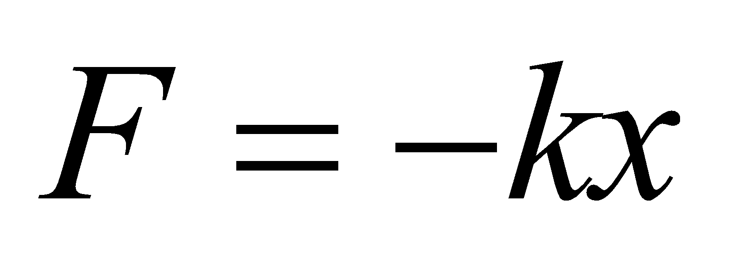
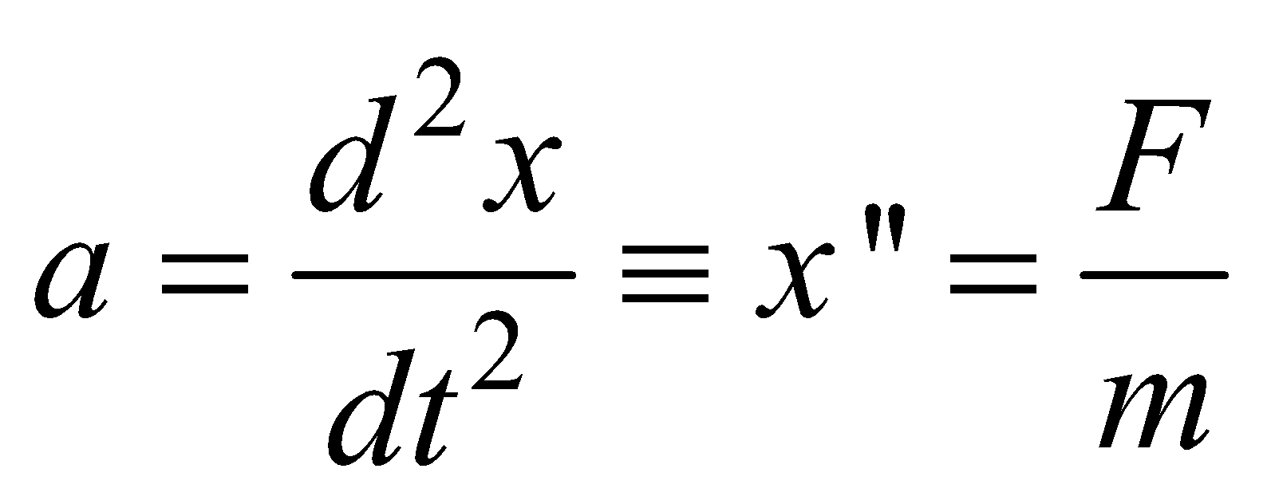
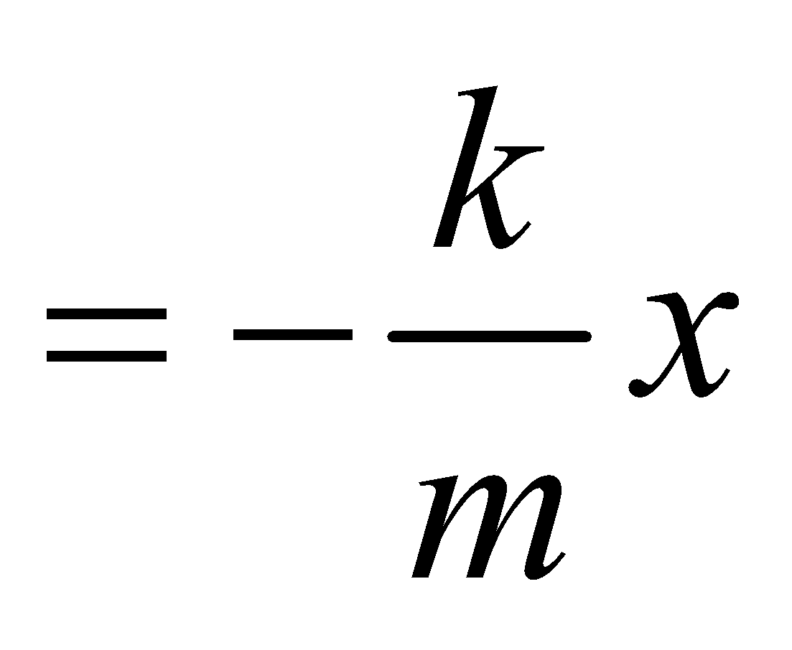
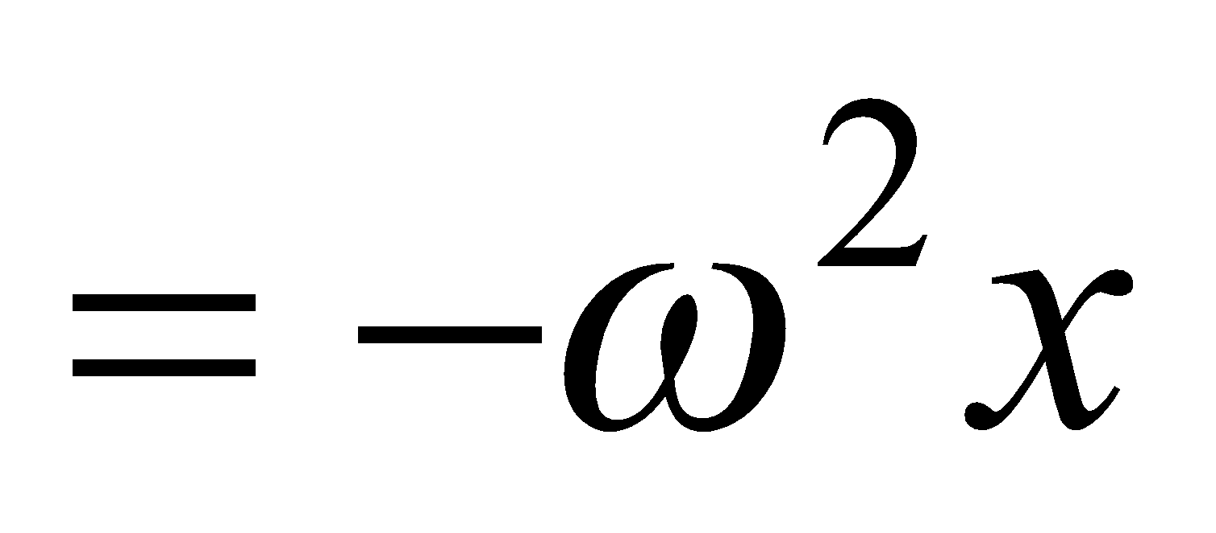
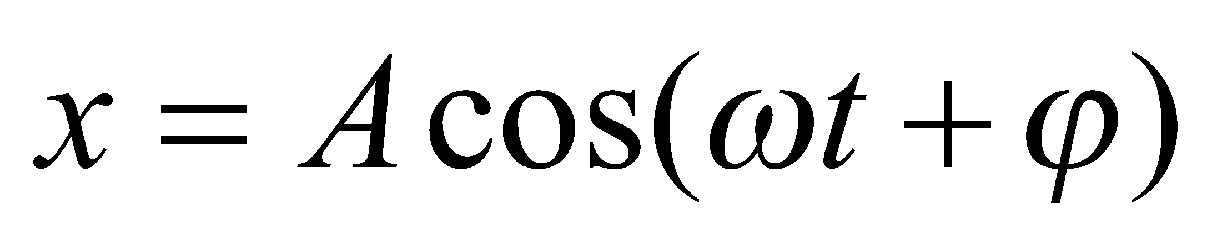
1. Vibration
a. Simple Harmonic Motion (SHM)
When the restoring force is directly proportional to the
displacement from equilibrium x (Hooke's law) :
the oscillation is called simple harmonic motion, abbreviated SHM.
Newton’s second law :
Solution :
(displacement in SHM)

Slide 7
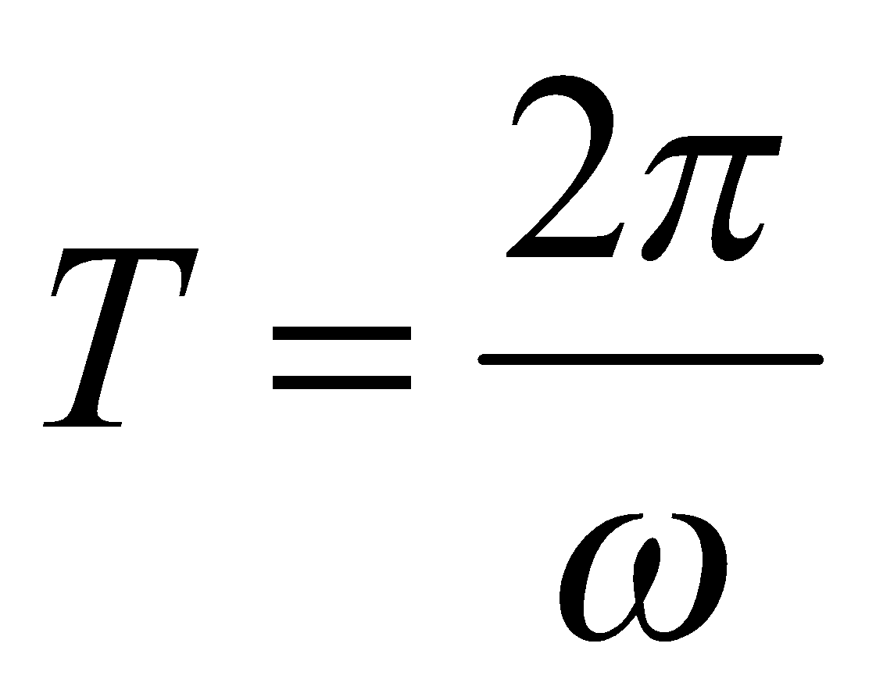
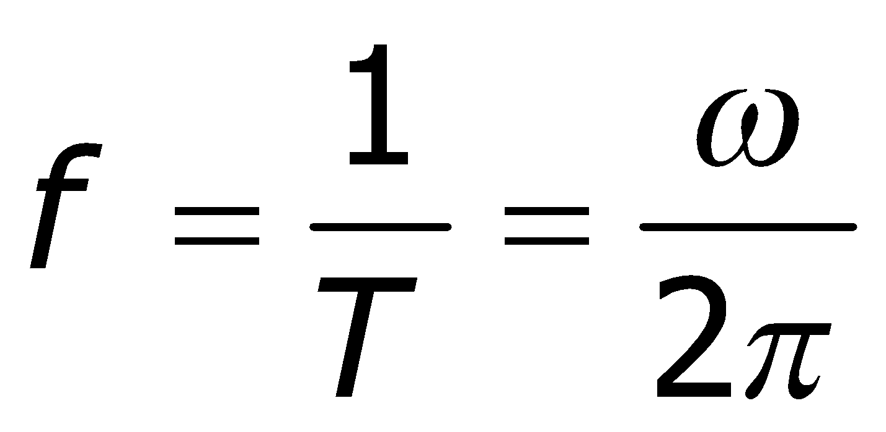
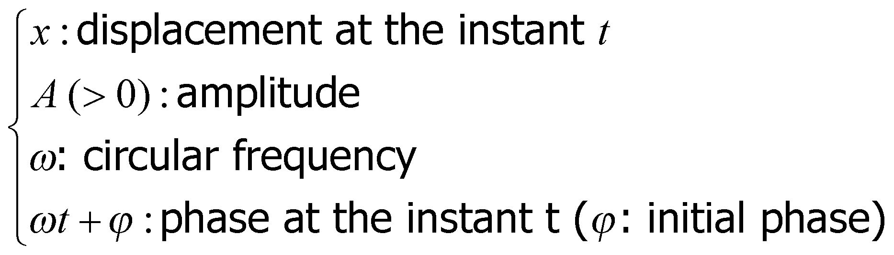
Solution :
(displacement in SHM)
The period :
The frequency :
(Hz-Hertz)

Slide 8
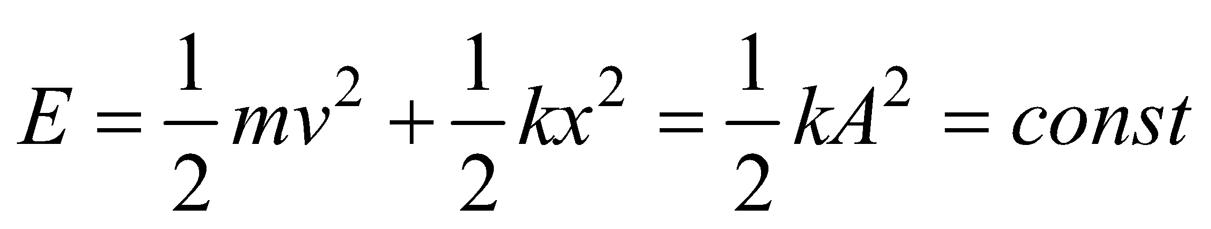
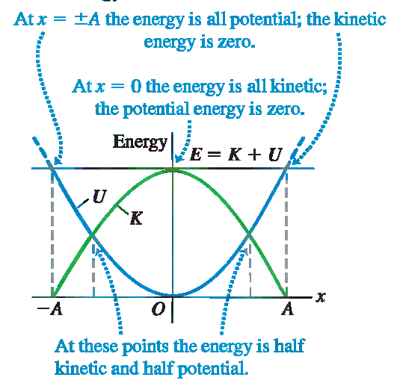
b. Energy in SHM
Total mechanical energy in SHM :

Slide 9
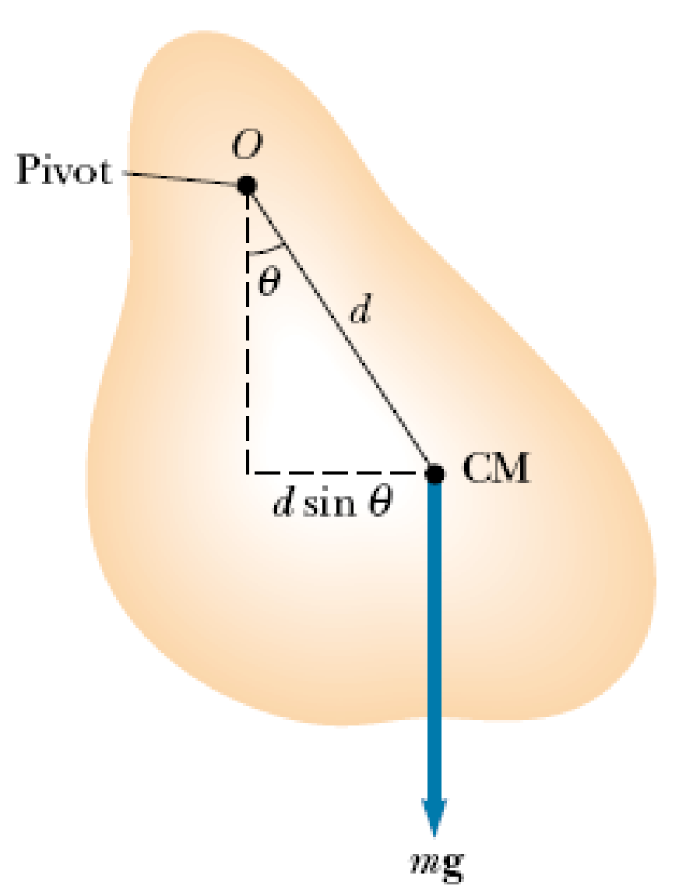
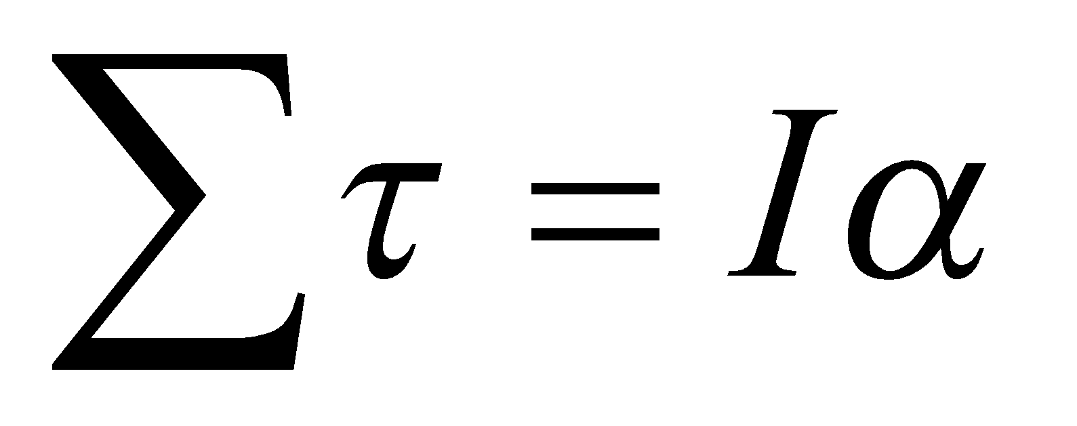
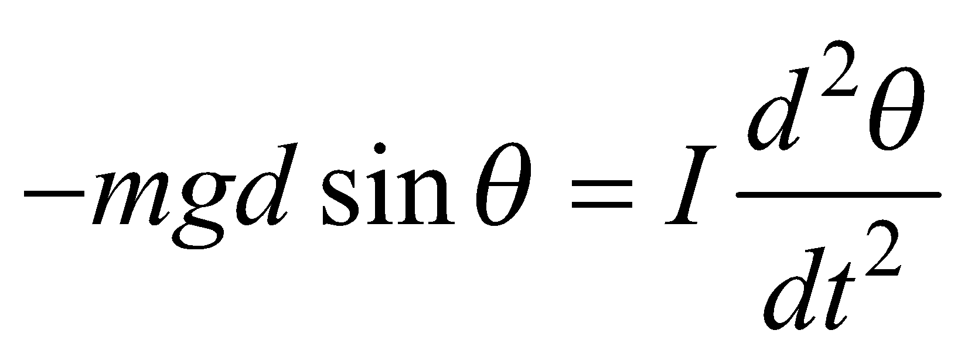
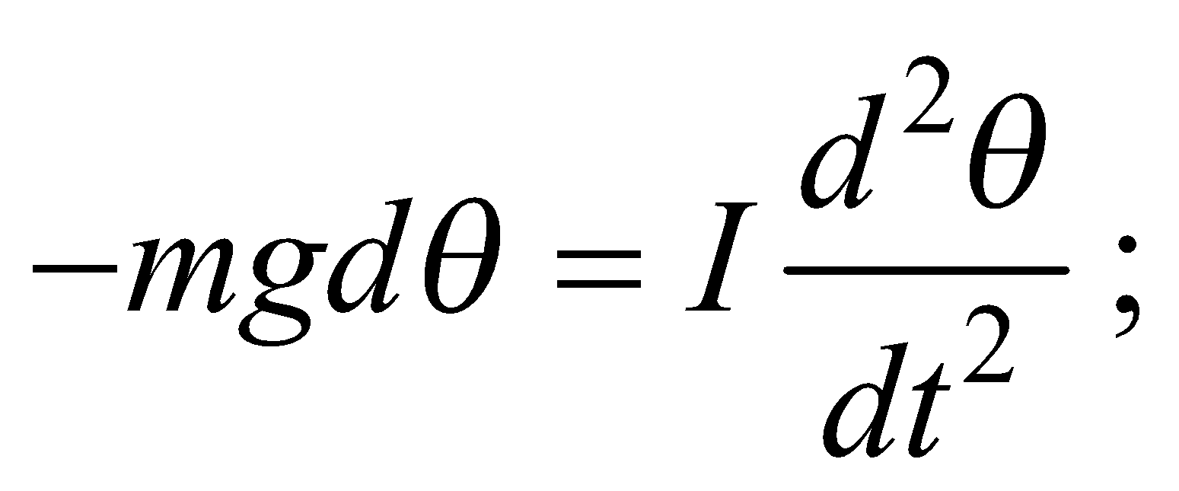
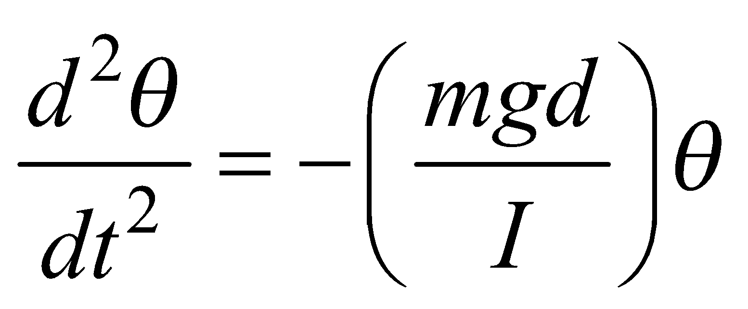
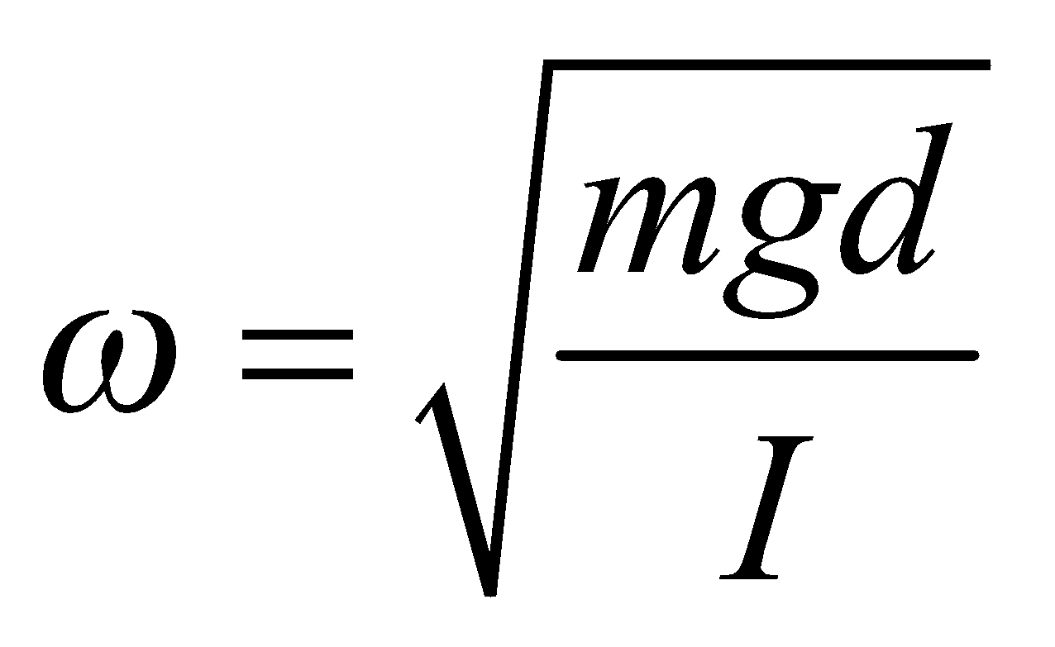
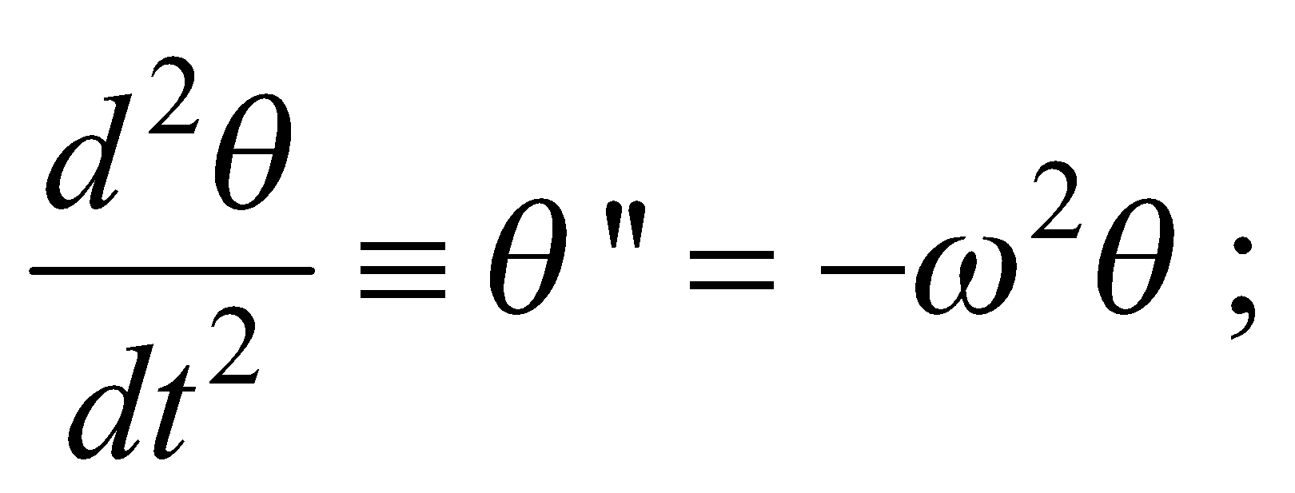
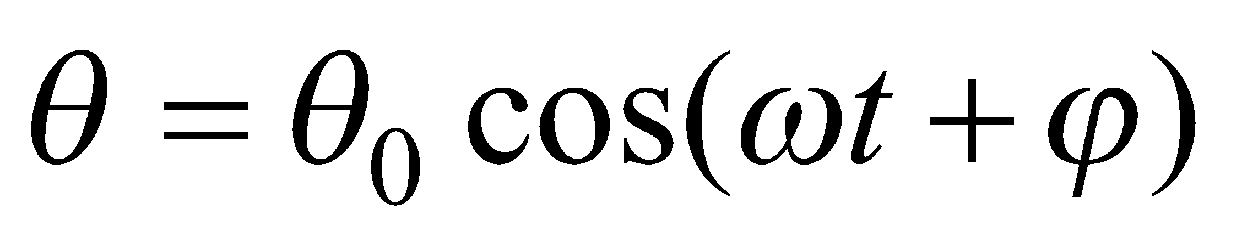
c. The Physical Pendulum
Consider a rigid body pivoted at a point O that is a distance d from the center of mass
The law of motion for a rigid body :
τ : torque about an axis through O
I : the moment of inertia about the axis through O
α : rotational acceleration
If θ small : sinθ ≈ θ
With :
(SHM)

Slide 10
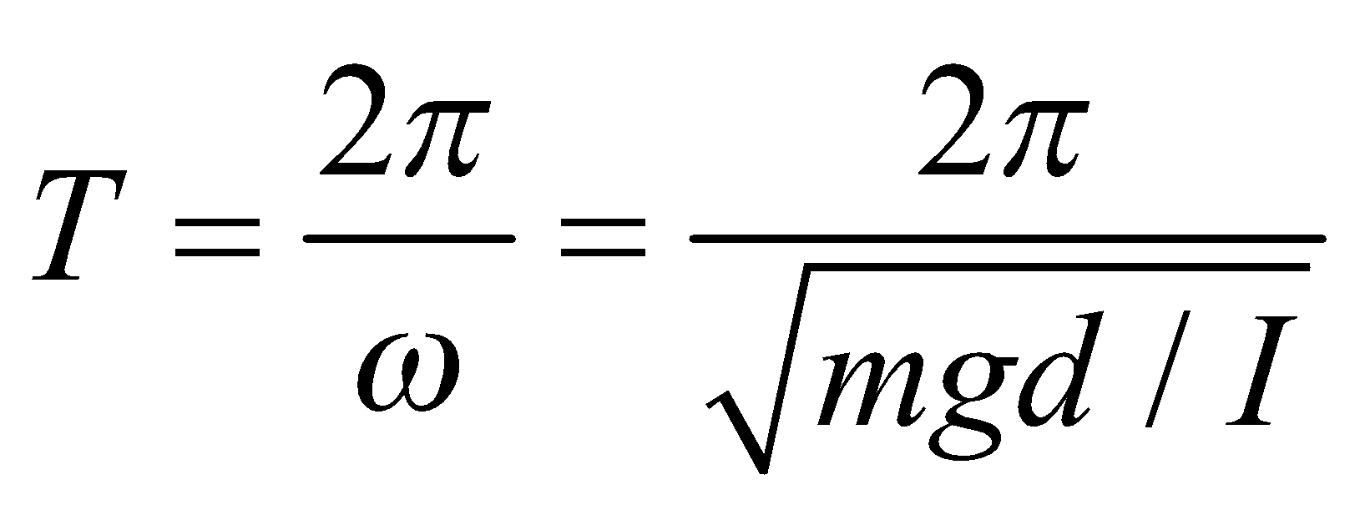
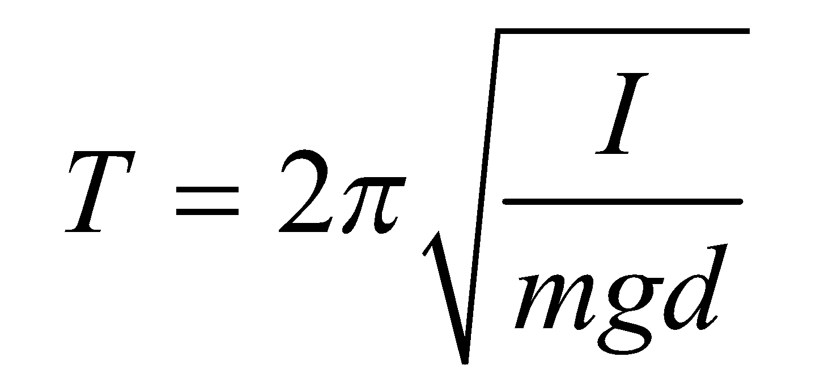
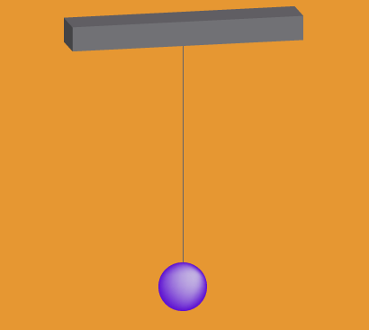

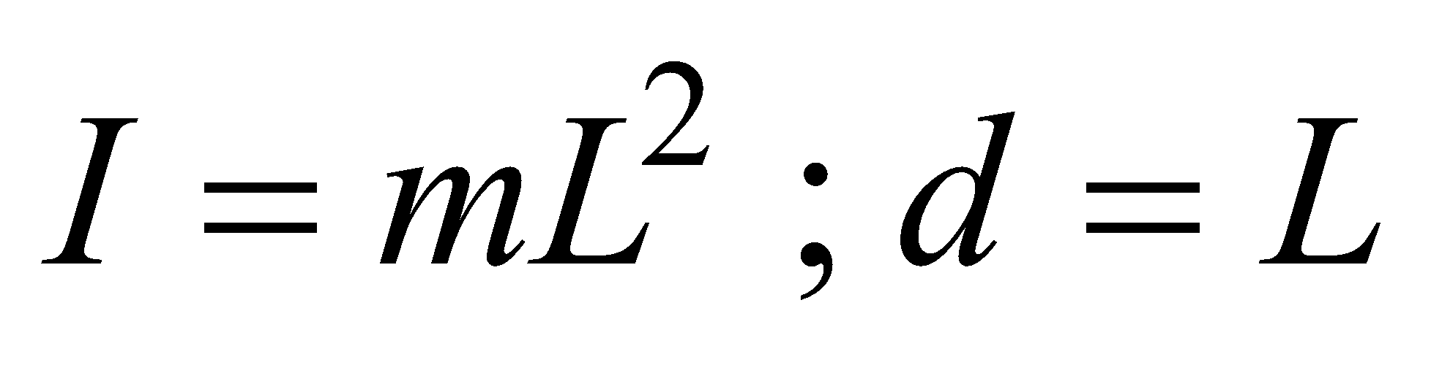
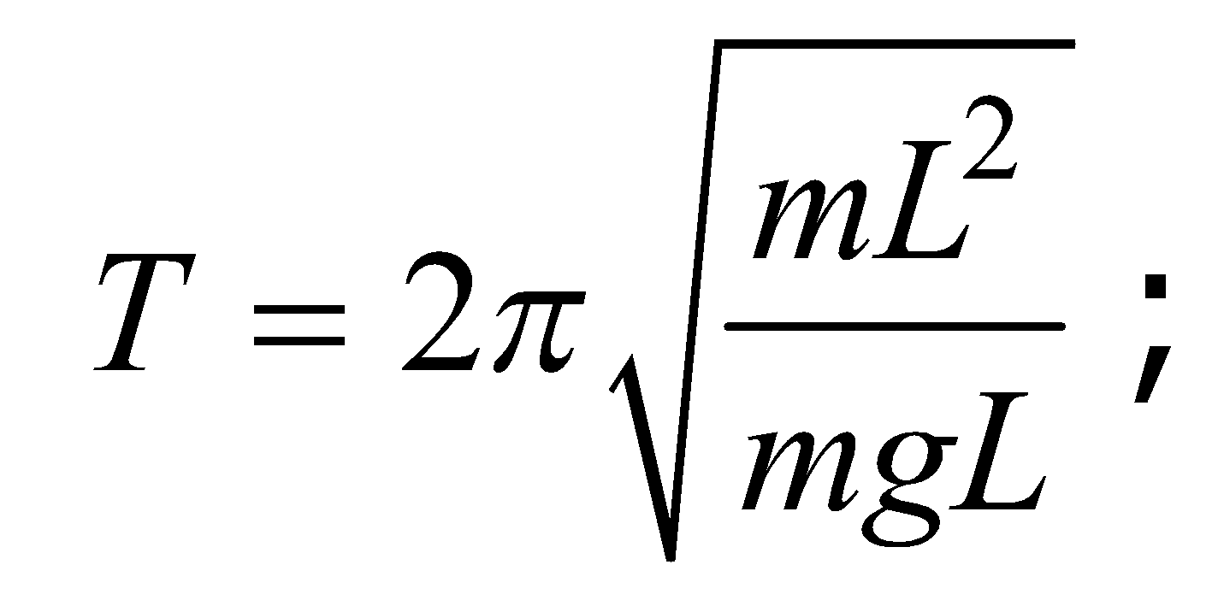
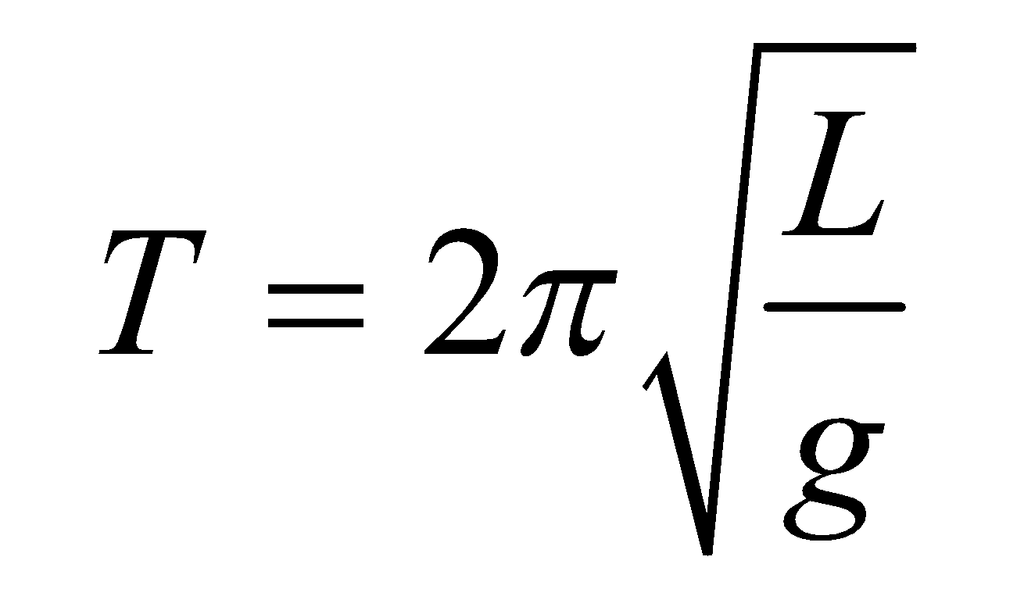
The period :
∙ A special case : The simple pendulum
(consisting of a particle-like bob of mass m suspended by a light string of length L that is fixed at the upper end)

Slide 11
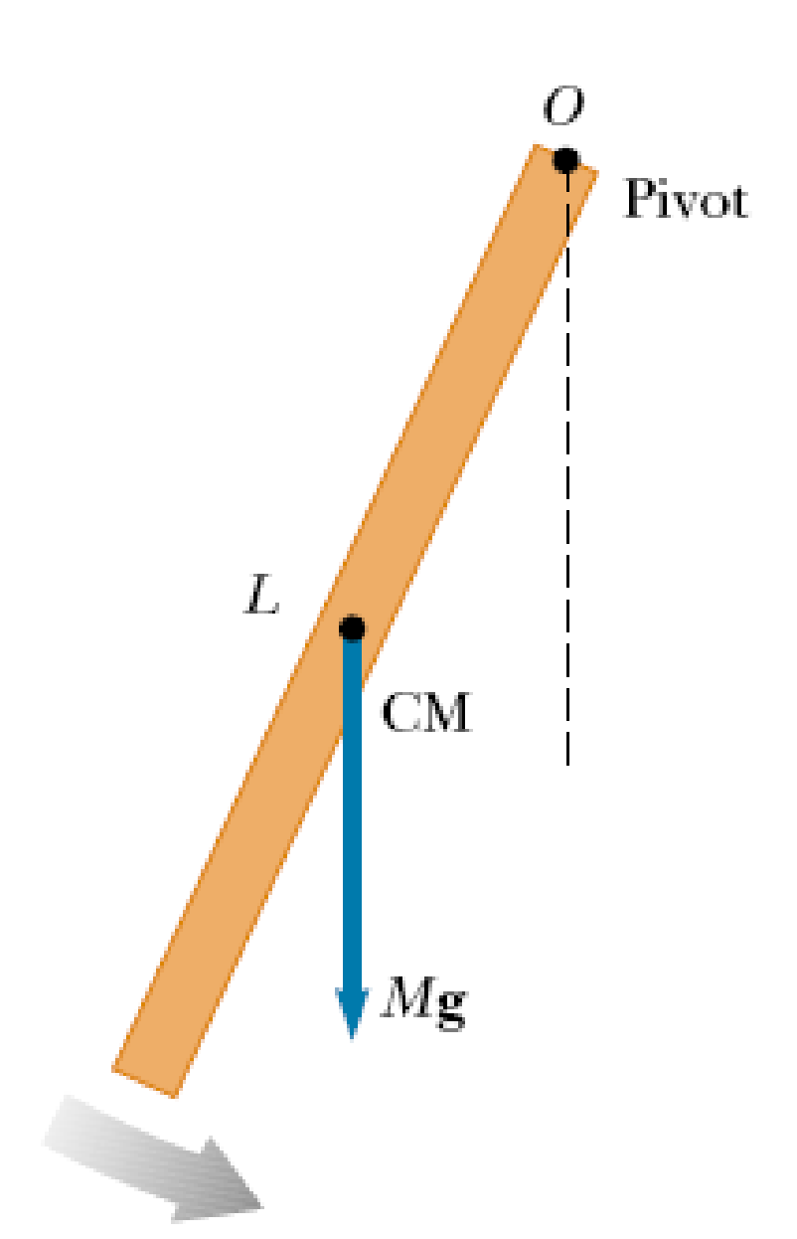
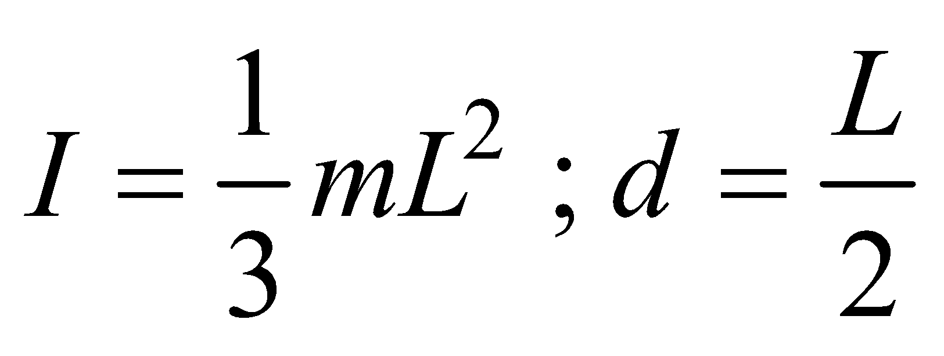
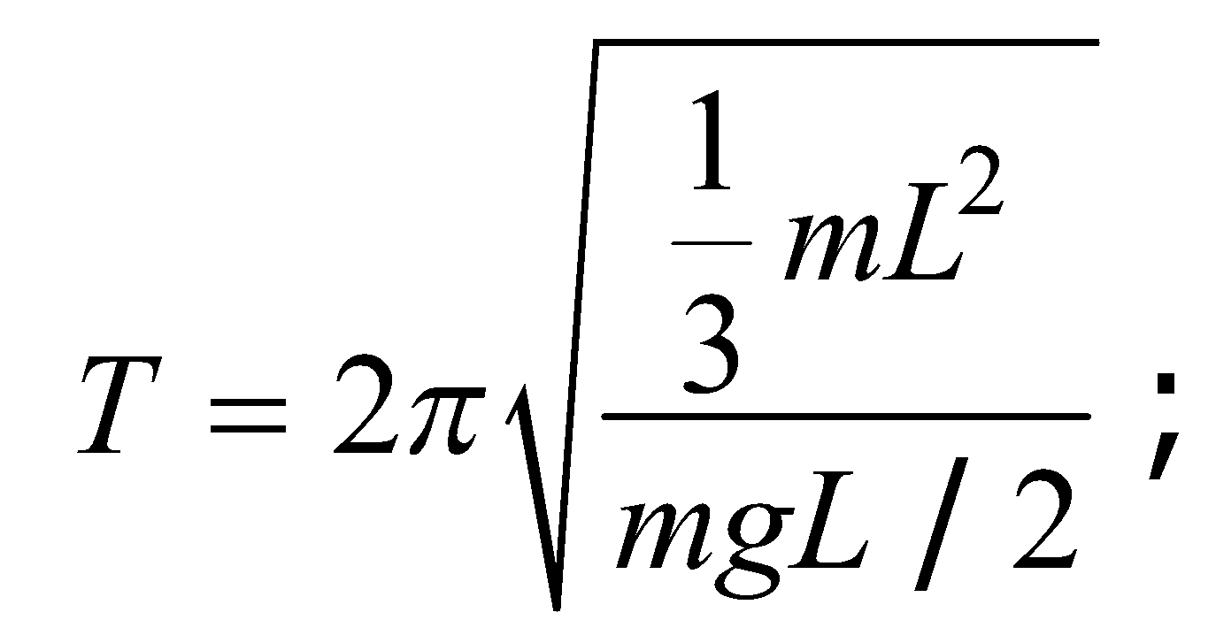
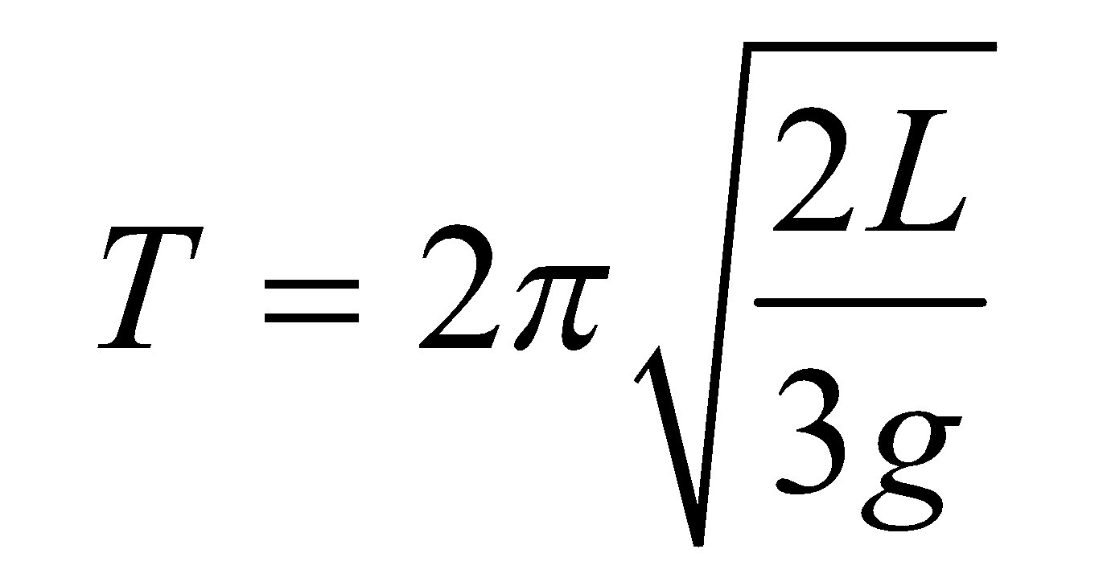
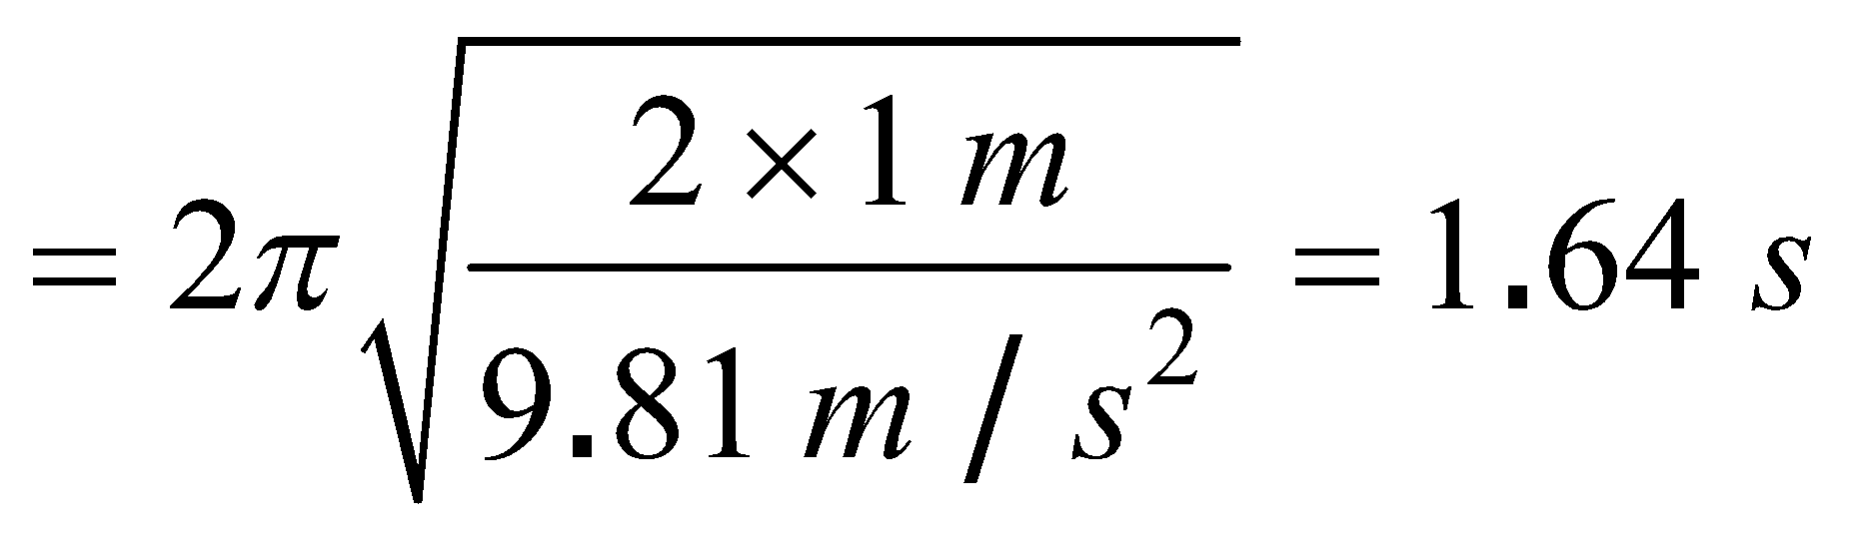
Calculate the period of a meter stick that is pivoted about one end and is oscillating in a vertical plane.
PROBLEM 1
SOLUTION
The moment of inertia :

Slide 12
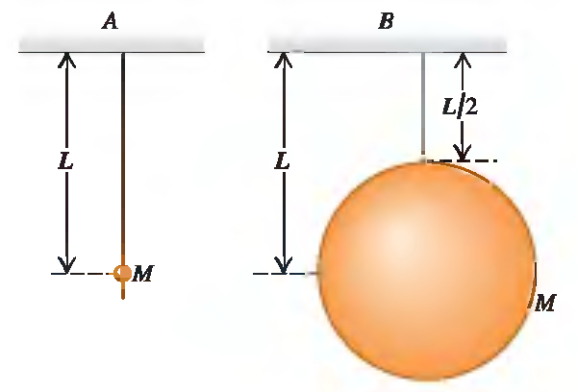
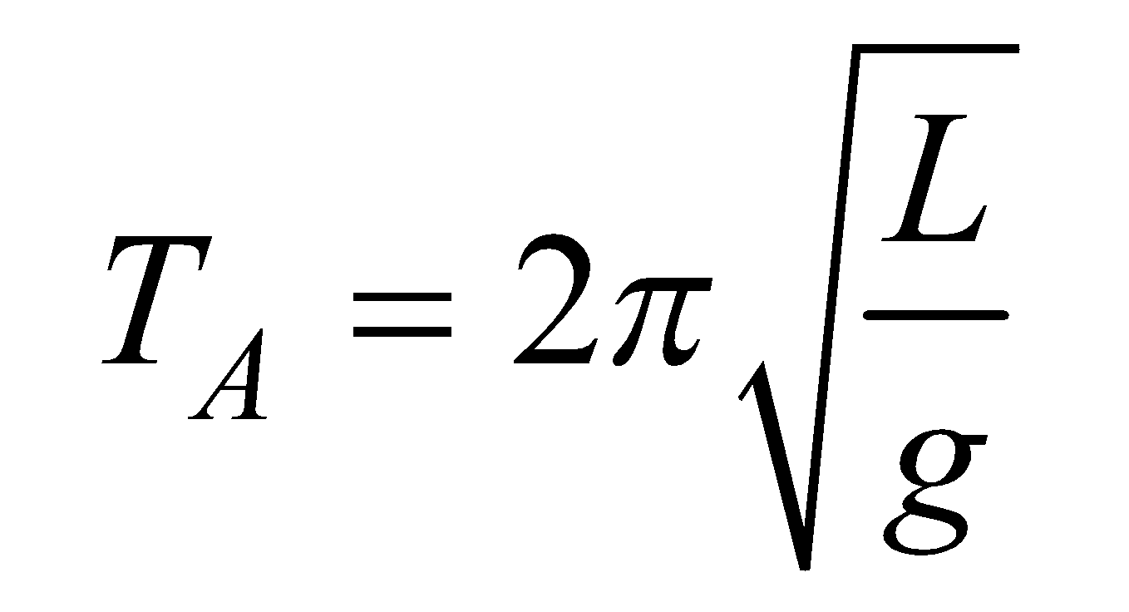
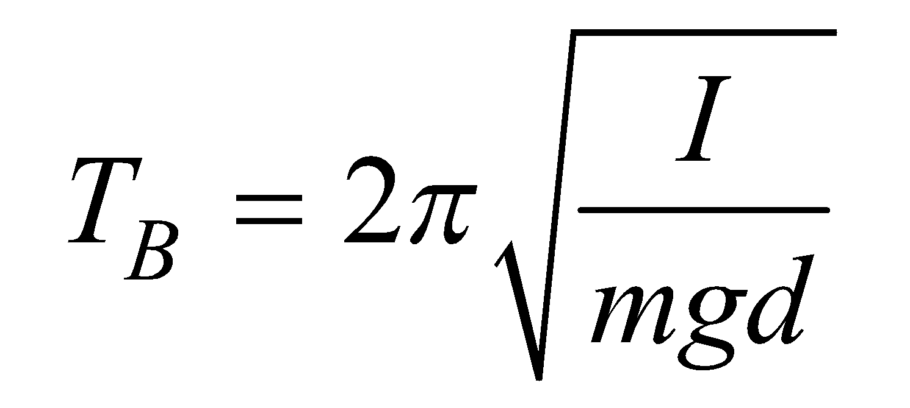
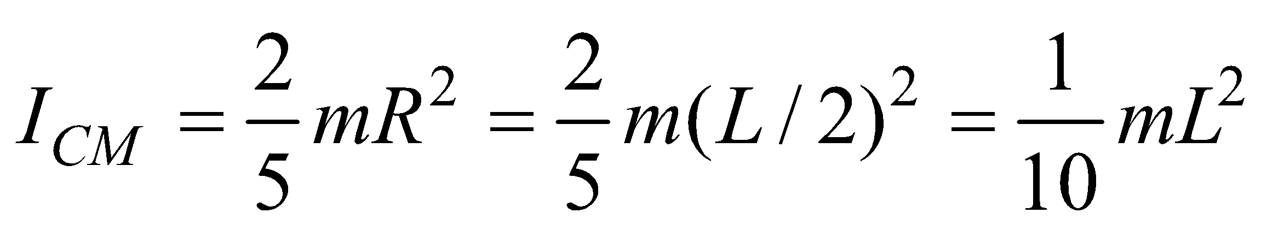
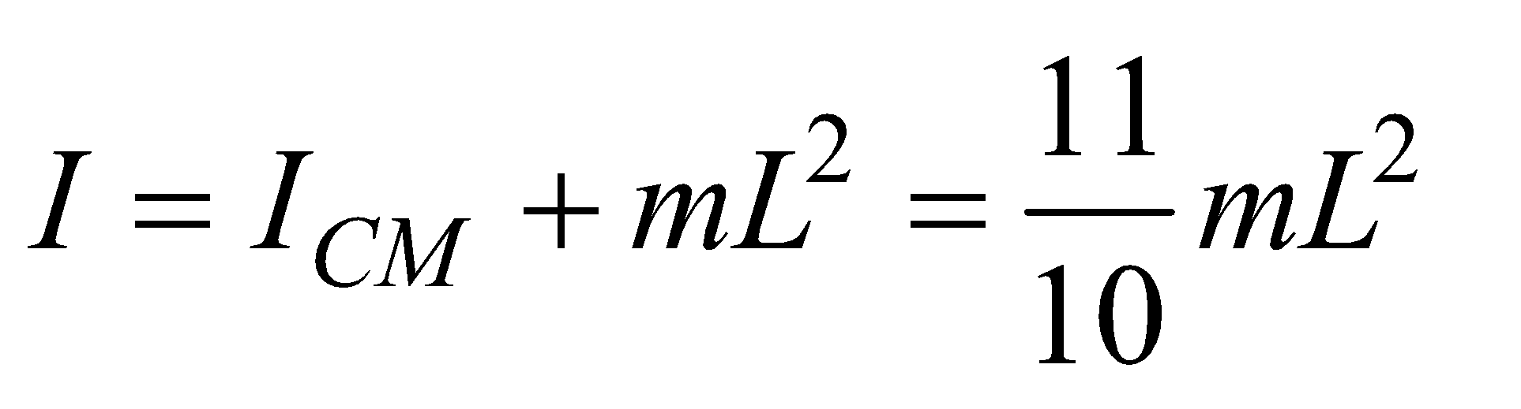
The two pendulums shown in the figure each consist of a uniform solid ball of mass M supported by a massless string, but the ball for pendulum A is very tiny while the ball for pendulum B is much larger. Find the period of each pendulum for small displacements. Which ball takes longer to complete a swing?
PROBLEM 2
SOLUTION
Pendulum A : simple pendulum:
Pendulum B is a physical pendulum :
For a solid sphere with an axis through its center :
The parallel-axis theorem says :

Slide 13
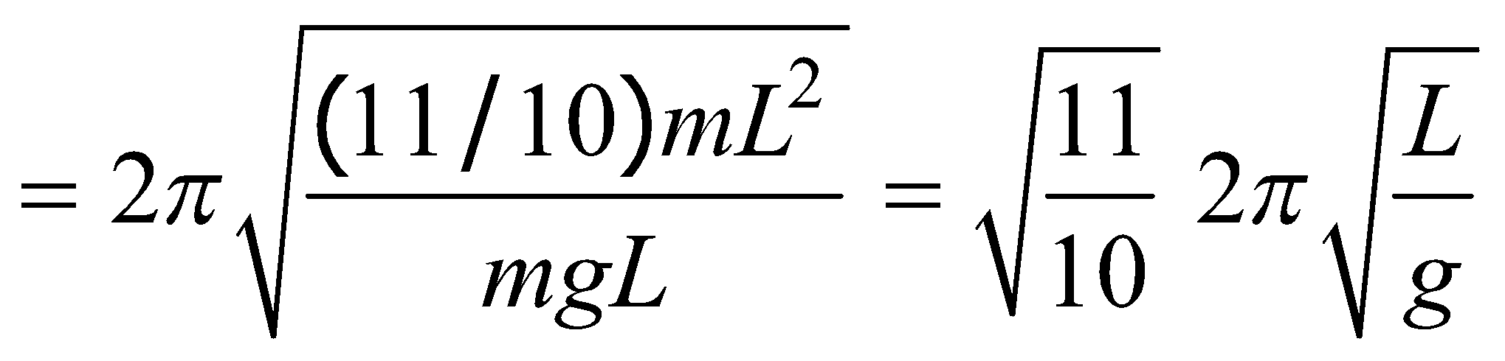
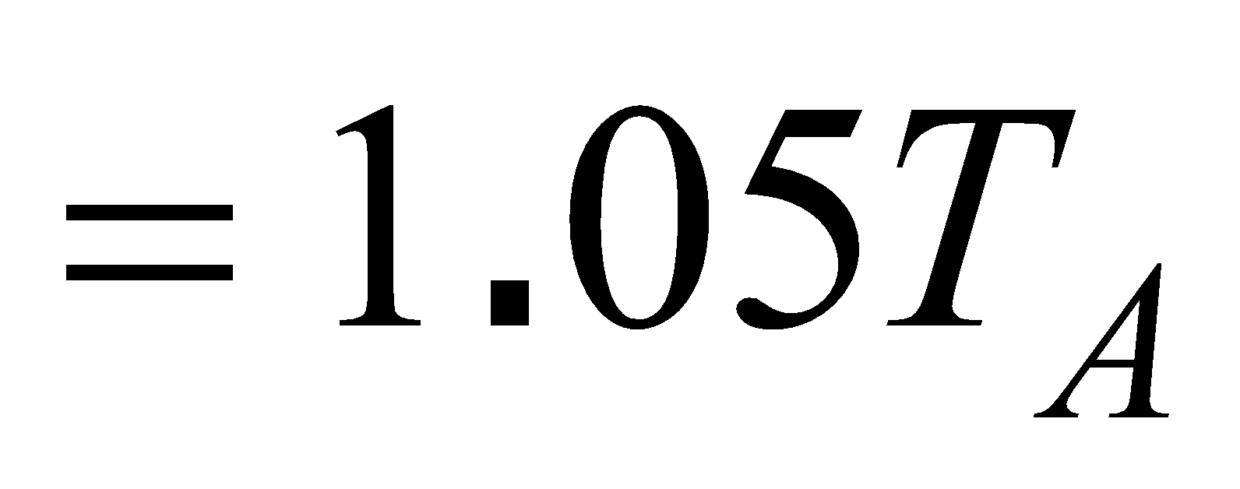
The two pendulums shown in the figure each consist of a uniform solid ball of mass M supported by a massless string, but the ball for pendulum A is very tiny while the ball for pendulum B is much larger. Find the period of each pendulum for small displacements. Which ball takes longer to complete a swing?
PROBLEM 2
SOLUTION
It takes pendulum B longer to complete a swing

Slide 14
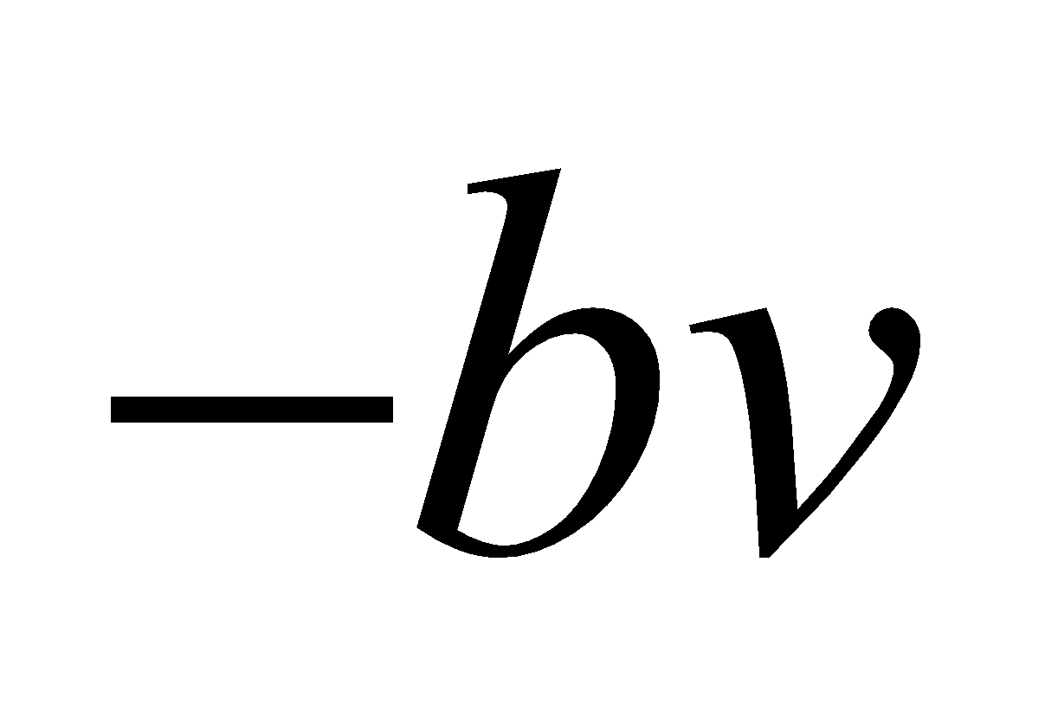
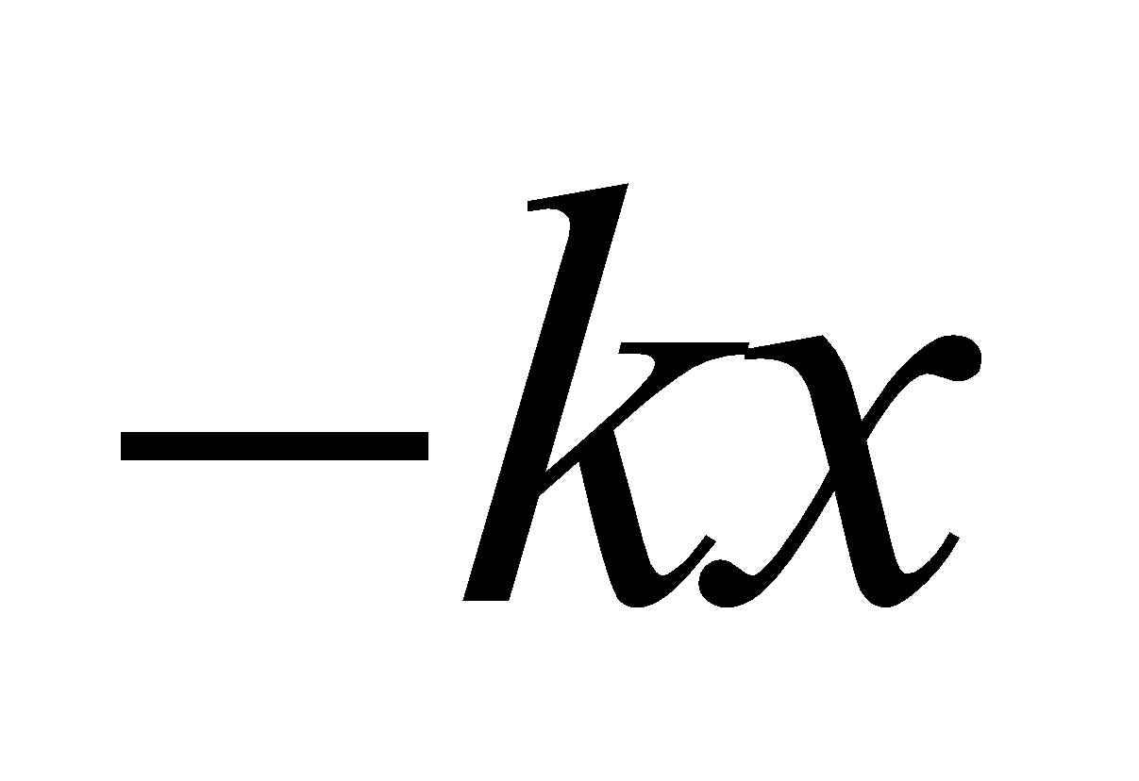
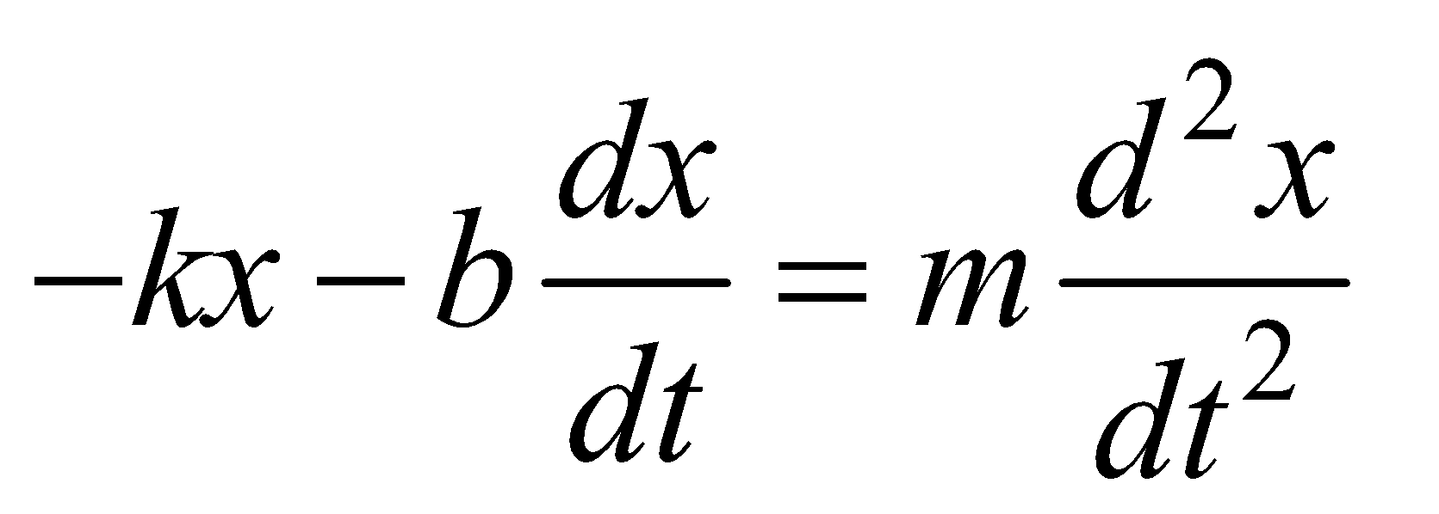
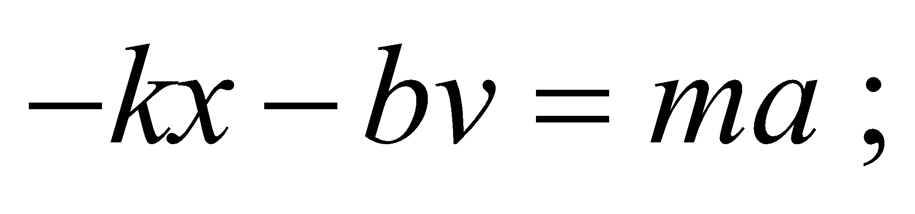
d. Damped Oscillations.
Forced Oscillations and Resonance
∙ Damped Oscillations
In many real systems, dissipative forces, such as friction, retard the motion → the mechanical energy of the system diminishes in time, and the motion is said to be damped.
In viscous fluid flow, additional force on the body due to friction :
v : velocity ; b :constant called the damping coefficient
The restoring force of the system :
Newton’s second law :

Slide 15
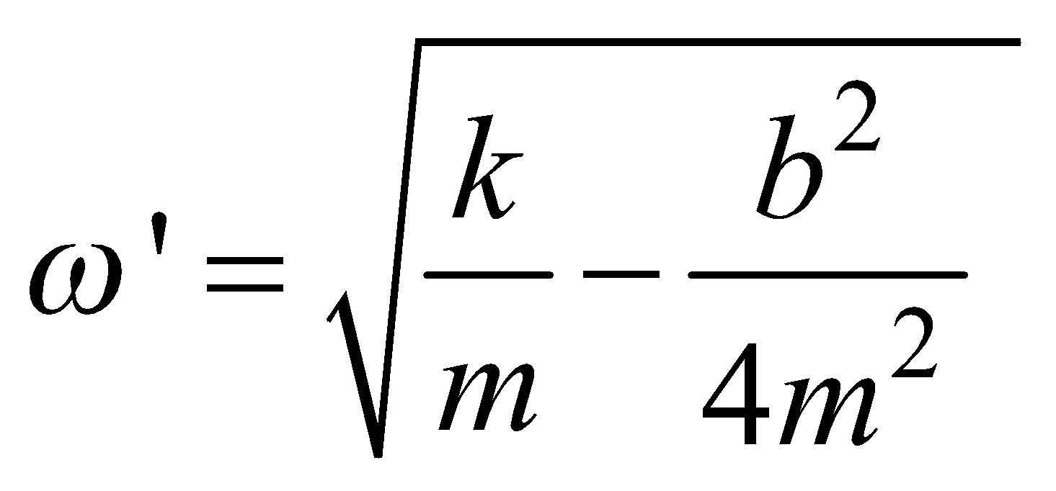
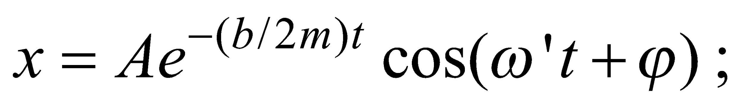
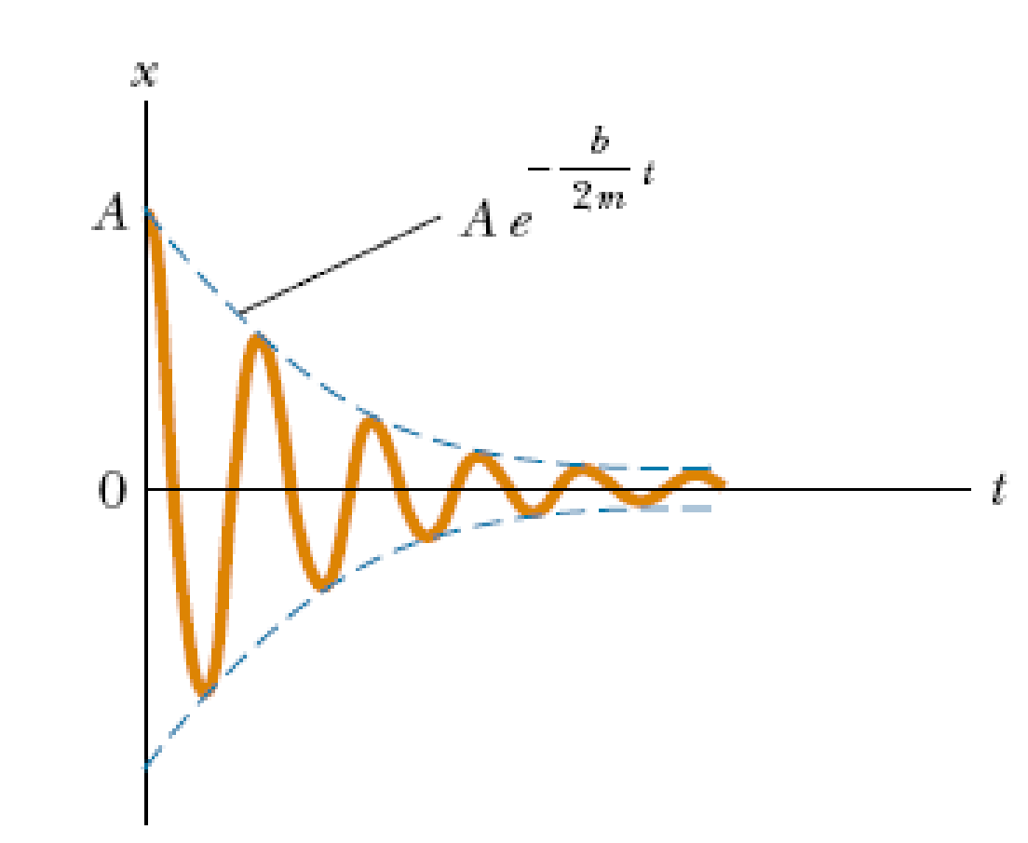
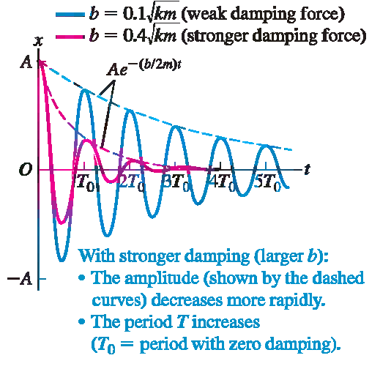
→ a differential equation for x
Solution (b small) :

Slide 16
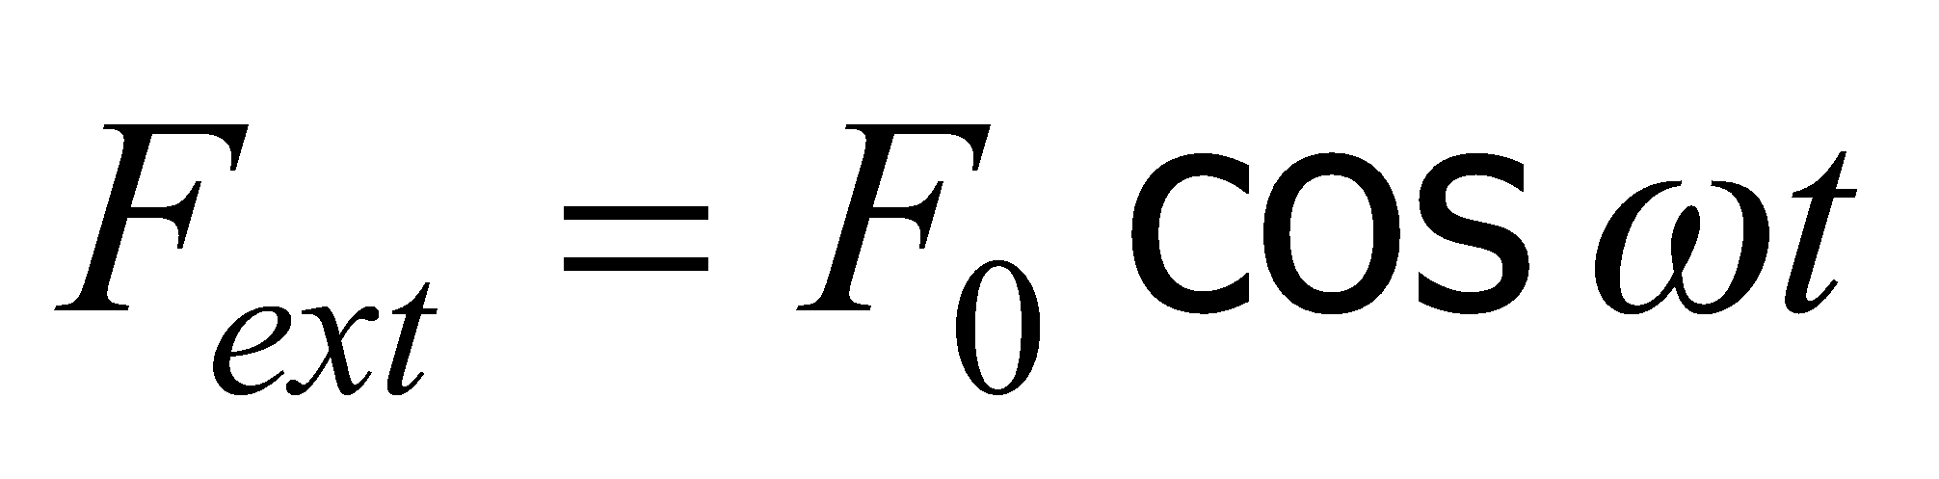
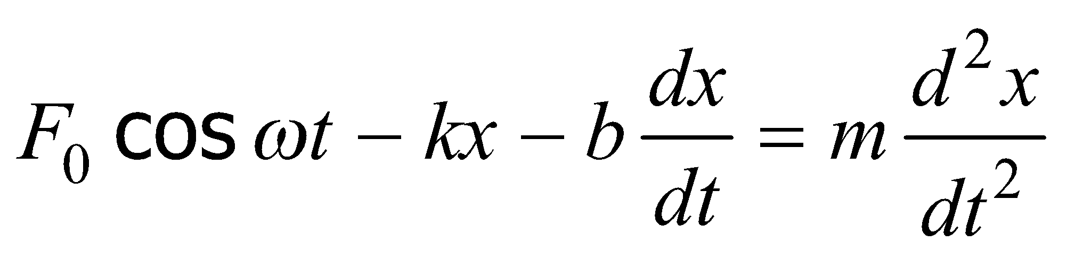
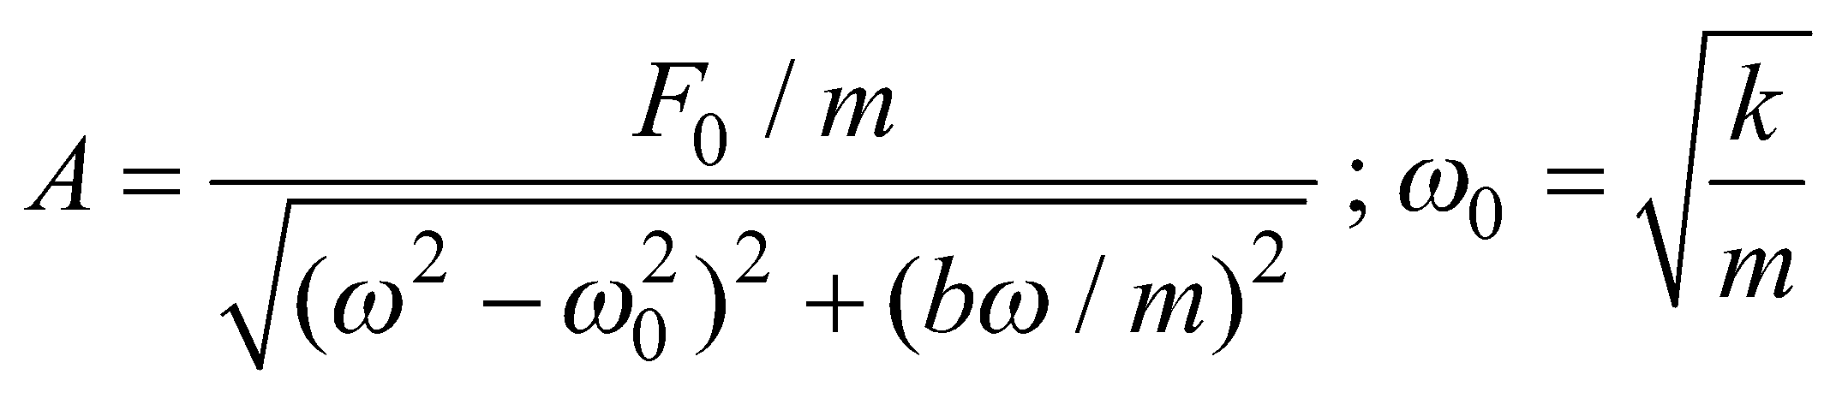
∙ Forced Oscillations and Resonance
How to compensate for energy loss in a damped system ?
Apply an external force that does positive work on the system
(driving force)
Example :
Newton’s second law :
With t large enough : a steady-state condition is reached in which the oscillations proceed with constant amplitude
(forced oscillation)

Slide 17
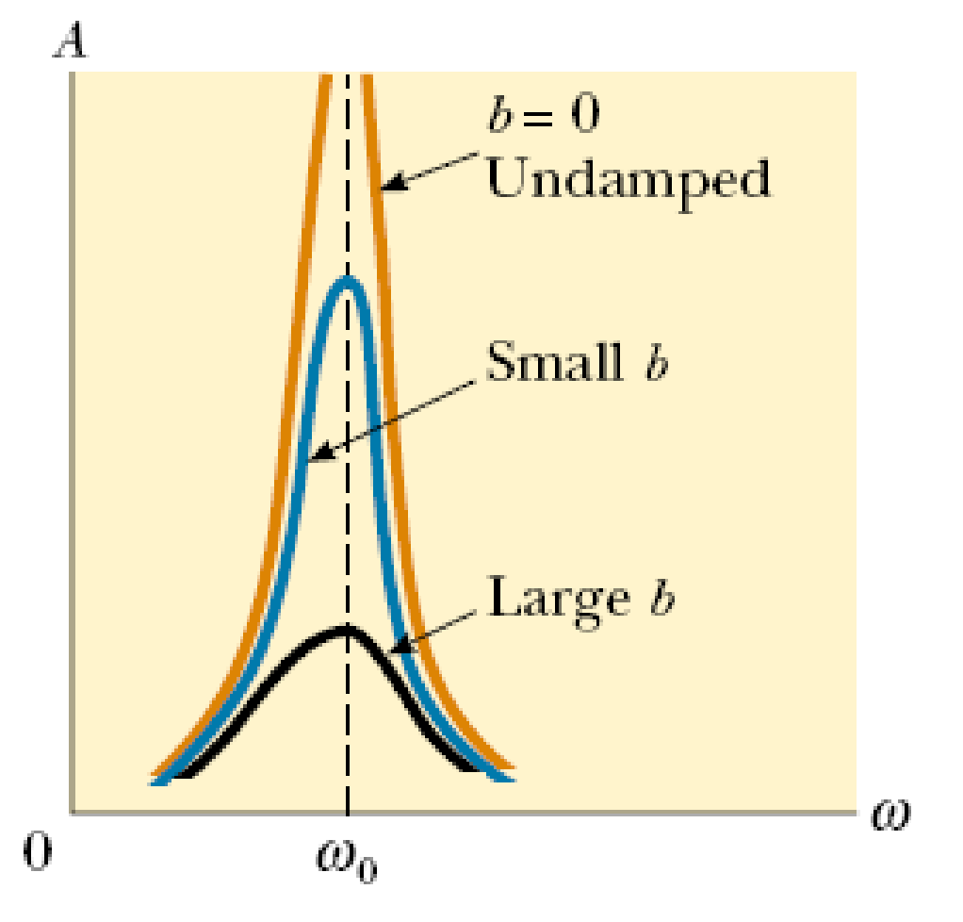
If ω → ω₀ : A becomes very large
→
resonance
( the applied force is in phase with the velocity and that the power transferred to the oscillator is a maximum )

Slide 18
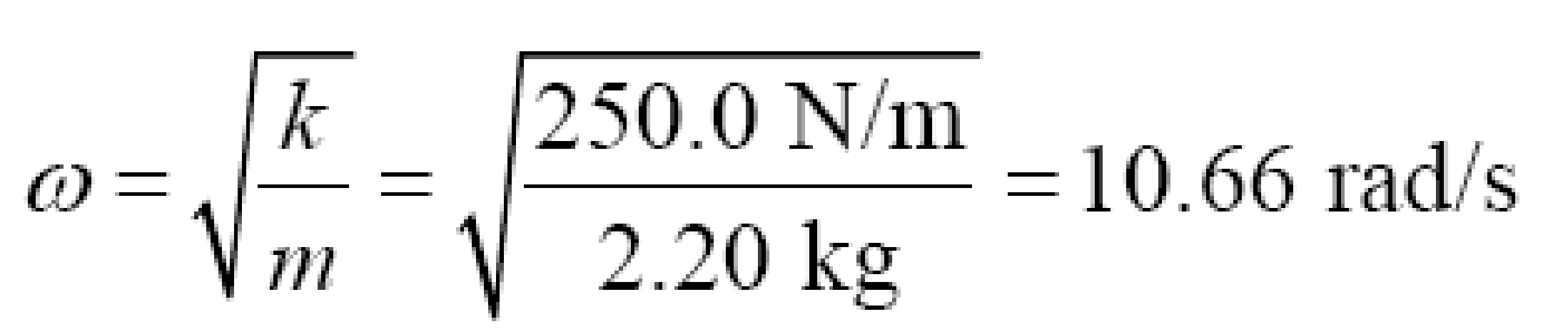

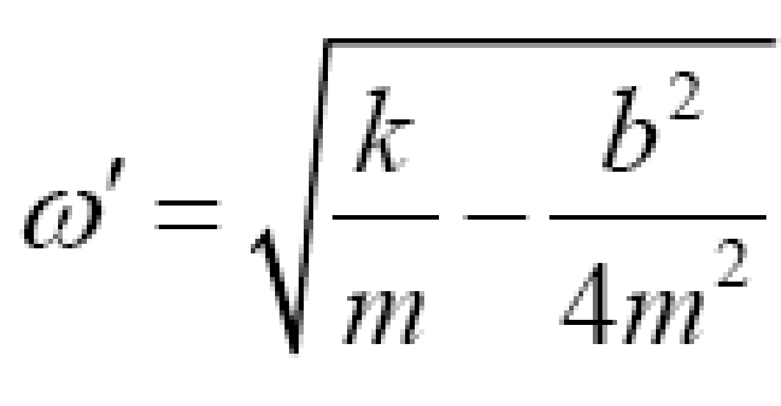


A 2.20-kg mass oscillates on a spring of force constant 250.0 N/m with a period of 0.615 s.
Is this system damped or not? If it is damped, find the damping constant.
PROBLEM 3
SOLUTION
→

Slide 19



A 50.0-g object moves on the end of a spring with
force constant k = 25.0 N/m. Its initial displacement is 0.300 m. A
damping force F = - bv acts on the object, and the amplitude of the
motion decreases to 0.100 m in 5.00 s. Calculate the magnitude of
the damping constant b.
PROBLEM 4
SOLUTION
→

Slide 20





2. Mechanical Wave
a. THE WAVE EQUATION
Wave: propagation of oscillation in space
Harmonic oscillation of A:
y
.
A
M
M begins to move after the time:
.
.
.
(v is the speed of the wave)
.
Motion of M :
.

Slide 21






Motion of M :
The wavelength :
The wave number :
Wave Equation :
http://www.phy.hk/wiki/englishhtm/TwaveA.htm

Slide 22



b. TYPES OF WAVES
∙ A traveling wave that causes the particles of the disturbed medium to move perpendicular to the wave motion is called a transverse wave.
∙ A traveling wave that causes the particles of the medium to move parallel to the direction of wave motion is called a longitudinal wave.
∙ Some waves in nature exhibit a combination of transverse and longitudinal displacements : Surface water waves

Slide 23








c. THE SPEED OF WAVES ON STRINGS
A transverse pulse traveling on a string with mass per unit length μ (kg/m)
A small segment of the string of length s
forms an approximate arc of a circle of radius R
Speed of the segment : v ,
T : the tension in the string
Total force on direction of R:
Mass of the segment :
Newton’s second law (radial component):

Slide 24









PROBLEM 5
A uniform cord has a mass of 0.300 kg and a length of 6.00 m.
The cord passes over a pulley and supports a 2.00-kg object.
1. Find the speed of a pulse traveling along this cord
2. Find the time it takes the pulse to travel from the wall to the pulley.
SOLUTION
1.
2.

Slide 25










d. CONSTRUCTION OF THE WAVE EQUATION
∙ A traveling wave is propagating along a string that is under a tension T.
∙ Δx : length of a small string segment
∙ Net force in the vertical direction :
∙ Newton’s second law :
The Partial Differential Equation of Wave

Slide 26





e. General form of a traveling wave
∙ A wave pulse traveling to the right with constant speed v on a long, taut string
∙ At t = 0 the shape of the pulse is given by y = f(x)
∙ At some later time t, the shape remains unchanged and the vertical displacement of any point P of the medium is given by
y = f(x - vt ).
The wave function measured in a stationary reference frame having its origin at O :
For the wave traveling to the left :
General form of a traveling wave :

Slide 27



PROBLEM 6
A wave pulse moving to the right along the x axis is represented
by the wave function
where x and y are measured in centimeters and t is measured
in seconds. Plot the wave function at t = 0 and t = 1.0 s
SOLUTION
∙ At t = 0 :

Slide 28


PROBLEM 6
A wave pulse moving to the right along the x axis is represented
by the wave function
where x and y are measured in centimeters and t is measured
in seconds. Plot the wave function at t = 0 and t = 1.0 s
SOLUTION
∙ At t = 1.0 s :

Slide 29



f. Representations of Waves
Wave fronts are the concentric arcs
The distance between successive wave fronts is the wavelength
Rays are the radial lines pointing out from the source and perpendicular to the wave fronts
A spherical wave propagates radially outward from the oscillating sphere
The energy propagates equally in all directions
Far away from the source, the wave fronts are nearly parallel planes
The rays are nearly parallel lines
A small segment of the wave front is approximately a plane wave

Slide 30





3 Superposition and Interference
a. Superposition principle for linear waves
“If two or more traveling waves are moving through a medium, the resultant wave function at any point is the algebraic sum of the wave functions of the individual waves.”
∙ Constructive interference
∙ Destructive interference

Slide 31









b. Superposition and Interference of Sinusoidal Waves
M
x₁
x₂
S₁
S₂
Phase difference
Path difference
Conclusion : The amplitude of the resultant wave is
2A⏐cos(φ/2)⏐, and its phase is φ/2 (+π)

Slide 32









Conclusion : The amplitude of the resultant wave is 2A cos(φ/2),
and its phase is φ/2
The amplitude of the resultant wave is 2A
(constructive interference)
The amplitude of the resultant wave is 0
(destructive interference)
In terms of path difference : δ = x₁ - x₂
Constructive interference :
Destructive interference :

Slide 33






A pair of speakers placed 3.00 m apart are driven
by the same oscillator. A listener is originally at point O, which is
located 8.00 m from the center of the line connecting the two
speakers.
1. The listener then walks to point P, which is a perpendicular
distance 0.350 m from O, before reaching the first minimum in
sound intensity. What is the frequency of the oscillator?
PROBLEM 7
SOLUTION
1.
For the first minimum :

Slide 34

A pair of speakers placed 3.00 m apart are driven
by the same oscillator. A listener is originally at point O, which is
located 8.00 m from the center of the line connecting the two
speakers.
2. If the oscillator frequency is adjusted such that the first location
at which a listener hears no sound is at a distance of 0.75 m from
O, what is the new frequency?
PROBLEM 7
SOLUTION
2.

Slide 35


Two small loudspeakers, A and B, are driven by
the same amplifier and emit pure sinusoidal waves in phase. If the
speed of sound is 350 m/s,
(a) for what frequencies does constructive interference occur at point P?
(b) For what frequencies does destructive interference occur at point P?
PROBLEM 8
SOLUTION

Slide 36

Two small loudspeakers, A and B, are driven by
the same amplifier and emit pure sinusoidal waves in phase. If the
speed of sound is 350 m/s,
(a) for what frequencies does constructive interference occur at point P?
(b) For what frequencies does destructive interference occur at point P?
PROBLEM 8
SOLUTION

Slide 37

Two small loudspeakers, A and B, are driven by
the same amplifier and emit pure sinusoidal waves in phase. If the
speed of sound is 350 m/s,
(a) for what frequencies does constructive interference occur at point P?
(b) For what frequencies does destructive interference occur at point P?
PROBLEM 8
SOLUTION

Slide 38




Two identical loudspeakers are located at points A
and B, 2.00 m apart. The loudspeakers are driven by the same
amplifier and produce sound waves with a frequency of 784 Hz.
Take the speed of sound in air to be 344 m/s. A small microphone
is moved out from point B along a line perpendicular to the line
connecting A and B (line BC).
(a) At what distances from B will there be destructive interference?
PROBLEM 9
SOLUTION
(These are the only allowable values of β
that give positive solutions for x)

Slide 39

Two identical loudspeakers are located at points A
and B, 2.00 m apart. The loudspeakers are driven by the same
amplifier and produce sound waves with a frequency of 784 Hz.
Take the speed of sound in air to be 344 m/s. A small microphone
is moved out from point B along a line perpendicular to the line
connecting A and B (line BC).
(b) At what distances from B will there be constructive interfer-
ence?
PROBLEM 9
(b)

Slide 40
PROBLEM 9
Two identical loudspeakers are located at points A
and B, 2.00 m apart. The loudspeakers are driven by the same
amplifier and produce sound waves with a frequency of 784 Hz.
Take the speed of sound in air to be 344 m/s. A small microphone
is moved out from point B along a line perpendicular to the line
connecting A and B (line BC).
(c) If the frequency is made low enough, there will be no positions
along the line BC at which destructive interference occurs. How low
must the frequency be for this to be the case?
(c) If h =λ /2, there will be destructive interference at speaker B. If λ /2 > h, the path difference can never be as large as λ /2. (This is also obtained from the above expression for x, with x = 0 and β = 1/2). The minimum frequency is then v/ 2h=(344 m s)/(4.0 m)=86 Hz.

Slide 41













4 STANDING WAVES
4.1 General consideration
Consider these two waves traveling in two opposite directions:
The combined wave is
∙ The amplitude is zero :
With the wave number :
we get the position of the nodes:
(n = 1, 2, 3,…)
∙ The amplitude is maximum :
We get the position of the antinodes :

Slide 42

A node occurs where the two traveling waves have the same magnitude of displacement, but the displacements are in opposite directions
Net displacement is zero at that point
The distance between two nodes is ½λ
An antinode occurs where the standing wave vibrates at maximum amplitude
antinode
λ/4
A
B
node
λ/2
λ/2
λ/2
λ/2

Slide 43





4.2 Standing waves in a string fixed at both ends
The string has a number of natural patterns of oscillation, called normal modes with wavelengths :
Frequencies of normal modes as functions of wave speed and length of string:
The lowest frequency f₁ , which corresponds to n = 1 is the fundamental :
The normal modes are called harmonics. The fundamental frequency f₁ is the frequency of the first harmonic; the frequency f₂ = 2f₁ is the frequency of the second harmonic; and the frequency f_{n} is the frequency of the nth harmonic

Slide 44


PROBLEM 10
Middle C on a piano has a fundamental frequency of 262 Hz,
and the first A above middle C has a fundamental frequency
of 440 Hz.
(a) Calculate the frequencies of the next two harmonics of the C
string.

Slide 45


PROBLEM 10
Middle C on a piano has a fundamental frequency of 262 Hz,
and the first A above middle C has a fundamental frequency
of 440 Hz.
(b) If the A and C strings have the same linear mass density and
length L, determine the ratio of tensions in the two strings.
SOLUTION

Slide 46




PROBLEM 11
The high E string on a guitar measures 64.0 cm in length and
has a fundamental frequency of 330 Hz. By pressing down on
it at the first fret, the string is shortened so that it plays an F note
that has a frequency of 350 Hz. How far is the fret from the neck
end of the string?
SOLUTION
The speed of the wave on the string :
The shortened string length :

Slide 47


4.3 Standing waves in air columns
In a pipe closed at one end, the closed end is a displacement node because the wall at this end does not allow longitudinal motion of the air molecules
The open end of an air column is approximately a displacement antinode (only odd harmonics are present)

Slide 48



PROBLEM 12
A section of drainage culvert 1.23 m in length makes a
howling noise when the wind blows.
(a) Determine the frequencies of the first three harmonics of
the culvert if it is open at both ends. Take 343 m/s as the
speed of sound in air.
SOLUTION
(a) The frequency of the first harmonic of a pipe open at both ends :

Slide 49



PROBLEM 12
A section of drainage culvert 1.23 m in length makes a
howling noise when the wind blows.
(b) What are the three lowest natural frequencies of the
culvert if it is blocked at one end?
SOLUTION
(b) The fundamental frequency of a pipe closed at one end :
Only odd harmonics are present :

Slide 50



PROBLEM 12
A section of drainage culvert 1.23 m in length makes a
howling noise when the wind blows.
(c) For the culvert open at both ends, how many of the
harmonics present fall within the normal human hearing
range (20 to 17 000 Hz)?
SOLUTION
(c) All harmonics are present
→ the frequency of the highest harmonic heard :
The number of harmonics present in the audible range :
(Only the first few harmonics are of sufficient amplitude to be heard)

Slide 51



5 NON-SINUSOIDAL WAVE PATTERNS
The sound-wave patterns produced by the majority of
musical instruments are non-sinusoidal
Fourier’s theorem : any periodic function can be represented
as a series of sine and cosine terms
Fourier series :

Slide 52





Example
Function approximates a saw-tooth signal:
f(t) = 1
Take one extra term in the series each time and drawing
separate graphs
f(t) = 1+2sint
f(t) = 1 + 2sin t - sin2t
f(t) = 1 + 2 sint - sin2t + 2/3 sin3t

Slide 53








6 Energy Transfer by Waves
Consider a sinusoidal wave traveling on a string.
A segment of the string of length Δx and mass Δm = μΔx
∙ The potential energy of this
segment :
y
v
With Δx → dx :
Choose t = 0 so that :
→
The total potential energy in one wavelength :

Slide 54




∙ The total kinetic energy in one wavelength:
∙ The total energy in one wavelength of the wave:
y
v
The power, or rate of energy transfer, associated with the wave :
→
The rate of energy transfer in any sinusoidal wave is proportional to the square of the angular frequency and to the square of the amplitude

Slide 55


7 Sound Waves
Sound waves are longitudinal waves traveling through a medium
A tuning fork : an example of producing a sound wave
A tuning fork will produce a pure musical note
As the tines vibrate, they disturb the air near them
As the tine swings to the right, it forces the air molecules near it closer together
This produces a high density area in the air
As the tine moves toward the left, the air molecules to the right of the tine spread out
This produces an area of low density
(a rarefaction)

Slide 56

As the tuning fork continues to vibrate, a succession of compressions and rarefactions spread out from the fork
A sinusoidal curve can be used to represent the longitudinal wave
Crests correspond to compressions and troughs to rarefactions

Slide 57

Categories of Sound Waves
Audible waves
Lay within the normal range of hearing of the human ear
Normally between 20 Hz to 20,000 Hz
Infrasonic waves: Frequencies are below the audible range
Ultrasonic waves: Frequencies are above the audible range
Intensity of Sound Waves
The intensity of a wave is the rate at which the energy flows through a unit area, A, oriented perpendicular to the direction of travel of the wave
P is the power, the rate of energy transfer
Units are W/m²

Slide 58

Threshold of hearing
Faintest sound most humans can hear
about I_{O} = 1 x 10⁻¹² W/m²
Threshold of pain
Loudest sound most humans can tolerate
about 1 W/m
The sensation of loudness is logarithmic in the human hear
β is the intensity sound level or the decibel level of the sound
I_{o} is the threshold of hearing
Threshold of hearing is 0 dB. Threshold of pain is 120 dB
Jet airplanes are about 150 dB. Normal conversation’s intensity level is about 50 dB.
Normal conversation’s intensity level is about 50 dB.

Slide 59





PROBLEM 13
A point source emits sound waves with an average power output of 80.0 W.
(a) Find the intensity 3.00 m from the source.
(b) Find the distance at which the sound level is 40 dB.
SOLUTION
(a)
(b)

Slide 60


PROBLEM 14
(a) By what factor must the sound intensity be increased to
raise the sound intensity level by 13.0 dB?
(b) Explain why you don't need to know the original sound intensity.
SOLUTION
(a)
(b)
The difference in two sound intensity levels is determined by the ratio of the sound intensities.

Slide 61




PROBLEM 15
Two identical machines are positioned the same distance
from a worker. The intensity of sound delivered by each
machine at the location of the worker is 2.0 × 10⁷ W/m². Find the sound level heard by the worker
(a) when one machine is operating and (b) when both machines are operating
SOLUTION
(a)
(b)
If there are three machines ?

Slide 62





7.1 The Doppler Effect
A Doppler effect is experienced whenever there is relative motion between a source of waves and an observer.
Although the Doppler effect is commonly experienced with sound waves, it is a phenomena common to all waves
An observer is moving toward a stationary source :
v : velocity of the sound. The frequency :
v_{o} is positive if the observer is moving toward the source and negative if the observer is moving away from the source

Slide 63






Source in Motion
The distance between to front waves :
v_{S} is positive when the source is moving toward the observer
and negative when the source moves away from the observer

Slide 64

In general :
Both the source and the observer could be moving
Use positive values of v_{o} and v_{s} if the motion is toward
Frequency appears higher
Use negative values of v_{o} and v_{s} if the motion is away
Frequency appears lower

Slide 65


PROBLEM 16
As an ambulance travels east down a highway at a speed of
33.5 m/s, its siren emits sound at a frequency of 400 Hz.
What frequency is heard by a person in a car traveling
west at 24.6 m/s?
as the car approaches the ambulance and
as the car moves away from the ambulance?
SOLUTION
(a)
(b)

Slide 66




PROBLEM 17
The police car with its 300-Hz siren is moving toward a
warehouse at 30 m/s, intending to crash through the door.
What frequency does the driver of the police car hear
reflected front the warehouse?
SOLUTION
Two stages of the sound wave's motion :
1 : Sound travels from police car's siren (source S) to warehouse
The frequency reaching the warehouse :

Slide 67




PROBLEM 15
The police car with its 300-Hz siren is moving toward a
warehouse at 30 m/s, intending to crash through the door.
What frequency does the driver of the police car hear
reflected front the warehouse?
SOLUTION
Two stages of the sound wave's motion :
2 : Reflected sound travels from warehouse (source ) to police car
The frequency heard by the driver :

